Slide 1
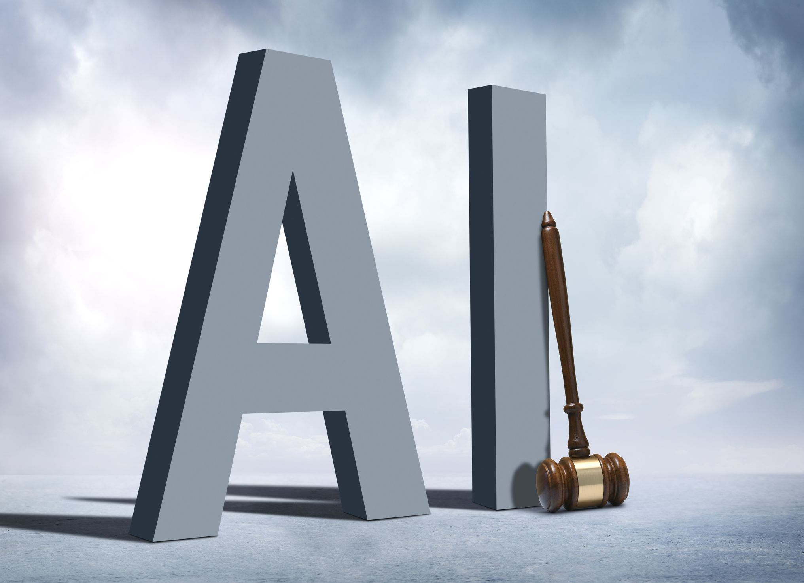
Artificial Intelligence Bias in Hiring Employee
Kh. Foysal Ahmed (2019-2-60-003)
Md Saiful (2019-2-60-040)
Fahad Ahmed (2020-2-60-174)

Slide 2

OUR SCENARIO
AI to select candidates for interviews
Ensuring fair and equal opportunities for all applicants
AI ranks male candidates higher than female
Release the AI system with bias
Delay the release

Slide 3
ETHICAL DILEMMA
Decisions | Probable Results
Release the AI system | Gender inequality, safe job
Delay the release | Risk Job, gender equality
WHAT WOULD BE THE DECISION?

Slide 4
ANALYSIS
Decision | Brainstorming | Analysis
 |  | Positive Impact | Negative Impact | Rights of stakeholders
Release the AI system | Gender discrimination Society risk Developer benefited | Developer job and family | Gender Inequality,AI Industry, Qualified Candidate | Everyone has right to treated as equal
Delay the release | Developer job risk Society benefited | Gender Equality,Hiring Process,Overall Industry Finance | Developer and his family

Slide 5

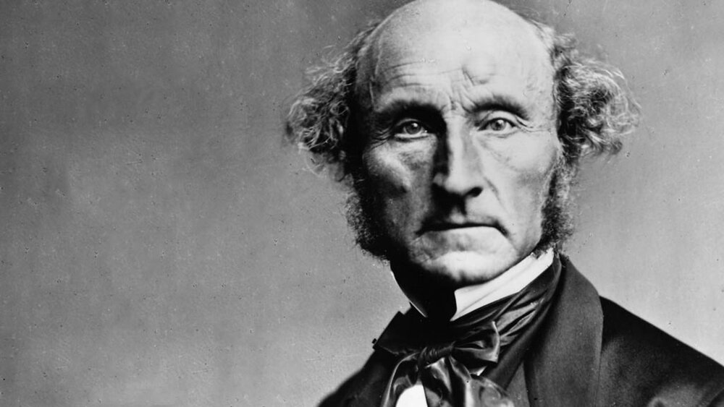

KANT’S, MILL’S, AND RAWLS’ APPROACHES
IMMANUEL KANT’S “CATEGORICAL IMPERATIVE” THEORY
MILL’S “UTILITARIAN THEORY” THEORY
JOHN RAWLS’S “THEORY OF JUSTICE”
The results or consequences of our actions which produces the greatest good for the most significant number.
According to this theory, delay the release of AI system
One should always respect the humanity of others and that one should only act following rules that could hold for everyone.
According to this theory, delay and build an accurate model
Everyone in the society holds equal fundamental rights whether someone is from a minority group, but it does not matter.
According to this theory, no decision can be made; in our scenario

Slide 6



ULTIMATE DECISION
Kant’s theory is, there is no option without accurate model.
Theory of Justice by Rawls is not practical for our case.
By following “Utilitarian theory”, we will delay the release of AI system has better utility than other cases.

Slide 7
THANK YOU

